Slide 1

Introductory Computer Networking and IT Security
Week 11

Slide 2
Agenda
Introductions to security policies and standards
Enterprise information security policy
Issue-specific security policy
System-specific policy
Frameworks and Industry Standards

Slide 3
Security policies and standards
  Policy is the essential foundation of an effective information security program. “The success of an information resources protection program depends on the policy generated, and on the attitude of management toward securing information on automated systems.
  You, the policy maker, set the tone and the emphasis on how important a role information security will have within your agency.
  Your primary responsibility is to set the information resource security policy for the organization with the objectives of reduced risk, compliance with laws and regulations and assurance of operational continuity, information integrity, and confidentiality.”

Slide 4
Security policies and standards
Why security policy ?
  A quality information security program begins and ends with policy.
  Policies are the least expensive means of control and often the most difficult to implement.
  Some basic rules must be followed when shaping a policy:
    Never conflict with law.
    Stand up in court.
    Properly supported and administered.
    Contribute to the success of the organization.
    Involve end users of information systems.

Slide 5
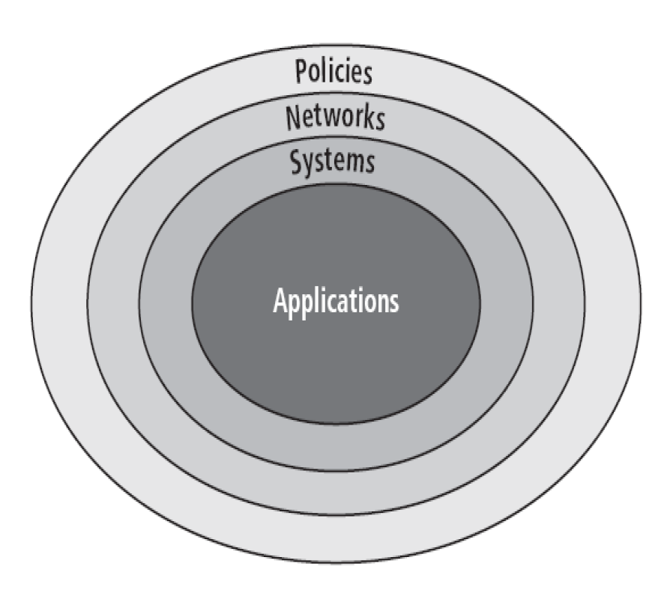
Security policies and standards
The Bull’s eye model

Slide 6
Security policies and standards
Bulls-eye model layers
  Policies — first layer of defense
  Networks — threats first meet the organization’s network.
  Systems — computers and manufacturing systems
  Applications — all applications systems
Policies are important reference documents for internal audits and for the resolution of legal disputes about management's due diligence, and policy documents can act as a clear statement of management's intent.

Slide 7
Policy, Standards, and Practices
  Policy is a plan or course of action that influences and determine decisions.
  -Eg. All email communication must be strongly encrypted
  Standards are a more detailed statement of what must be done to comply(act accordingly) with Policy Practices.
  -Eg. Use an encryption that is not yet proven to be breakable in less than 30 minutes.
  Procedures and Guidelines explain how employees will comply with policy.
  -Eg. Provide WiFi router with AES Encryption connected to a manageable switch.
  For policies to be effective, they must be:
    Properly disseminated, read, understood, and agreed-to
    Policies require constant modification and maintenance.

Slide 8
Types of Security Policies
  Enterprise Information Security Policy
  Issue-Specific Information Security Policies
  Systems-Specific Information Security Policies

Slide 9
Enterprise Information Security Policy (EISP)
  Sets strategic direction, scope, and tone for organization’s security efforts.
  Assigns responsibilities for various areas of information security.
  Guides development, implementation, and management requirements of information security program.

Slide 10
Enterprise Information Security Policy (EISP)
  EISP documents should provide :
    An overview of the corporate philosophy on security
    Information on the information security organization and information security roles
      Responsibilities for security that are shared by all members of the organization
      Responsibilities for security that are unique to each role within the organization

Slide 11
Enterprise Information Security Policy (EISP)
  EISP examples
    Protection of Information
    Use of information
    Information handling
    Violation of law
    Exceptions to Policies

Slide 12
Issue-Specific Security Policy (ISSP)
  Provides detailed, targeted guidance to instruct the organization in secure use of technology systems, and begins with introduction to fundamental technological philosophy of the organization.
  Serves to protect employee and organization from inefficiency and ambiguity; documents how the technology-based system is controlled; and identifies the processes and authorities that provide this control.
  Serves to indemnify(compensate (someone) for harm or loss.) the organization against liability for an employee’s inappropriate or illegal system use.
Notes:
Indemnify-penalty

Slide 13
Issue-Specific Security Policy (ISSP)
ISSP topics could include:
  Electronic mail
  Use of the Internet and the World Wide Web
  Specific minimum configurations of computers to defend against worms and viruses
  Prohibitions against hacking or testing organization security controls
  Home use of company-owned computer equipment
  Use of personal equipment on company networks
  Use of telecommunications technologies, and use of photocopy equipment

Slide 14
Components of the ISSP
  Statement of Purpose
    Scope and applicability
    Definition of technology addressed
    Responsibilities
  Authorized Access and Usage of Equipment
    User access
    Fair and responsible use
    Protection of privacy

Slide 15
Components of the ISSP
  Prohibited Usage of Equipment
    Disruptive use or misuse
    Criminal use
    Offensive or harassing materials
    Copyrighted, licensed, or other intellectual property
    Other restrictions
  Systems Management
    Management of stored materials
    Employer monitoring
    Virus protection
    Physical security
    Encryption

Slide 16
Components of the ISSP
  Violations of policy
    Procedures for reporting violations
    Penalties for violations
  Policy review and modification
    Scheduled review of policy and procedures for modification
  Limitations of liability
    Statements of liability or disclaimers

Slide 17
Systems-Specific Policy (SysSP)
  Systems-Specific Policies (SysSPs) frequently do not look like other types of policy.
  They may often be created to function as standards or procedures to be used when configuring or maintaining systems.
  SysSPs can be separated into:
    Management guidance
    Technical specifications
    Combined in a single policy document

Slide 18
Systems-Specific Policy (SysSP)
  Management Guidance SysSPs
    Created by management to guide the implementation and configuration of technology.
  Applies to any technology that affects the confidentiality, integrity or availability of information.
  Informs technologists of management’s intent.

Slide 19
Systems-Specific Policy (SysSP)
  Technical Specifications SysSPs
    System administrator’s directions on implementing managerial policy
  Each type of equipment has its own type of policies.
  There are two general methods of implementing such technical controls:
    Access Control Lists
    Configuration Rules

Slide 20
Guidelines for policy development
  It is often useful to view policy development as a two-part project
    First designs and develops the policy (or redesigns and rewrites an outdated policy)
    Second establishes management processes to perpetuate the policy within the organization
  The former is an exercise in project management, while the latter requires adherence to good business practices.
Notes:
perpetuate –conserve , preserve adherence-attachment or commitment to a person , cause, or belief

Slide 21
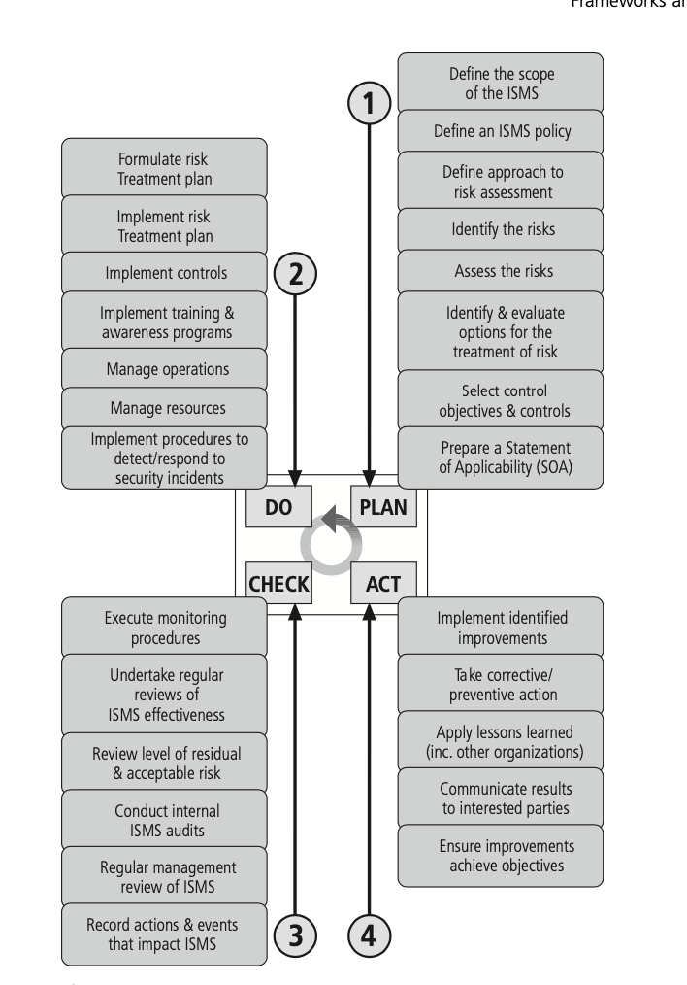
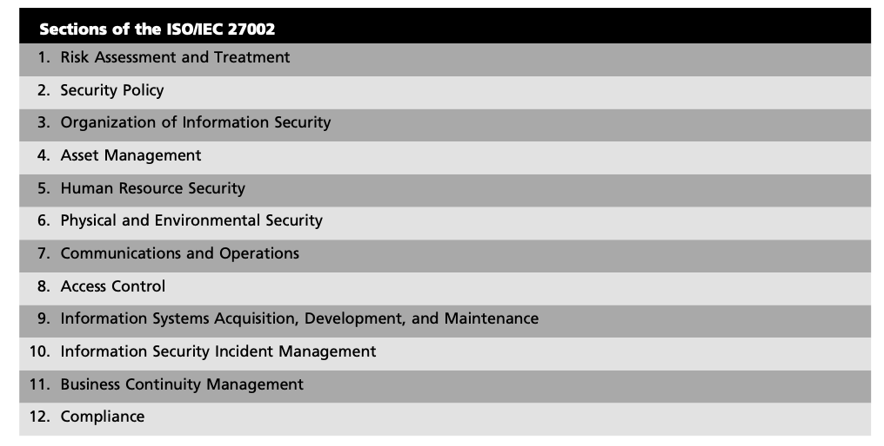
Frameworks and Industry Standards
The ISO 27000 Series

Slide 22
Thank You

